Slide 1
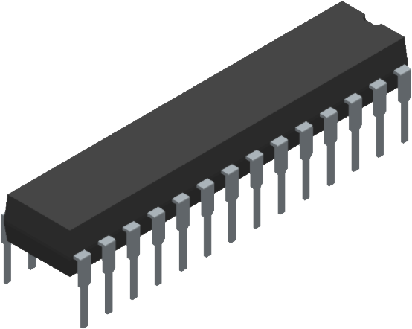
Water Level Indicator
MINI
PROJECT
Embedded Systems Design Projects
EEE2301
Presented by : Malindu Kanishka (23ug1-0015)
: Ransilu Samadhith (23ug1-0117)

Slide 2
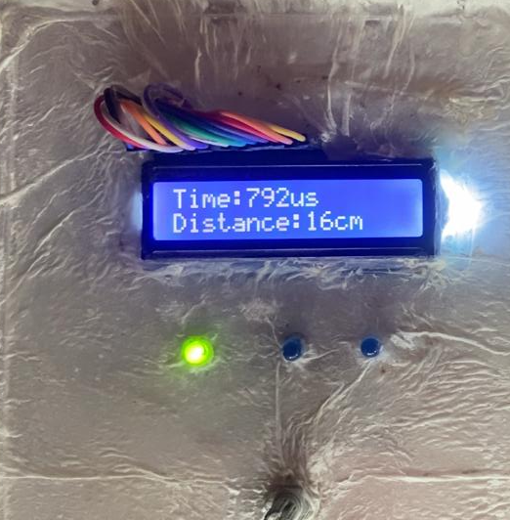
Water Level Monitoring Problem & SolutionC
"Our project addresses the critical issue of waterlevel management,
which is essential in various applications such as agriculture, industrial
tanks, and domestic water systems. Inconsistent or inaccurate monitoring
can lead to significant water wastage, flooding, or insufficient supply.
To solve this, we developed a real-time water level indicator system using
the PIC16F877A microcontroller. This system provides continuous monitoring, accurate measurements, and timely alerts, ensuring efficient water management and preventing potential hazards."
.

Slide 3
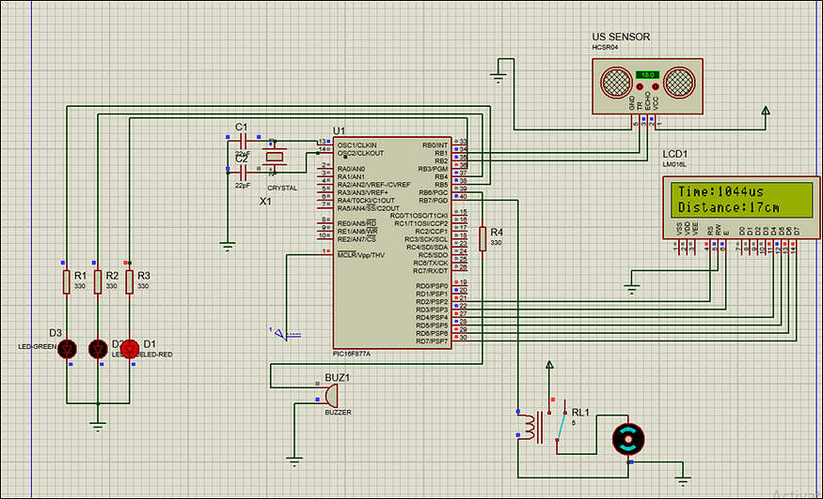
Hardware and System Design!
Key Components:
List critical components (e.g., PIC16F877A, ultrasonic sensor, LCD display, LEDs).
Justify their selection: "The PIC16F877A was chosen for its compatibility and processing capability, ultrasonic sensors for their accuracy."

Slide 4
Results & Conclusion
Project Outcomes:
Summarize the results: "The system accurately monitored water levels, providing real-time feedback and reliable alerts."
Analysis:
Discuss any unexpected results or improvements made: "Addressed EMI interference through improved shielding."
Conclusion:
Summarize the success and future prospects: "The project successfully met its objectives and provides a foundation for future enhancements in water level monitoring."

Slide 5
THANK YOU!

